Slide 1
In class practice: In-place quick-sort modifies the input sequence using element swapping and does not explicitly create subsequences. Show how the in-place quick sort works on the sequence
76 | 15 | 45 | 1 | 20 | 83 | 6 | 55 | 16 | 50

Slide 2
Graphs
Everything can be a Graph Problem

Slide 3
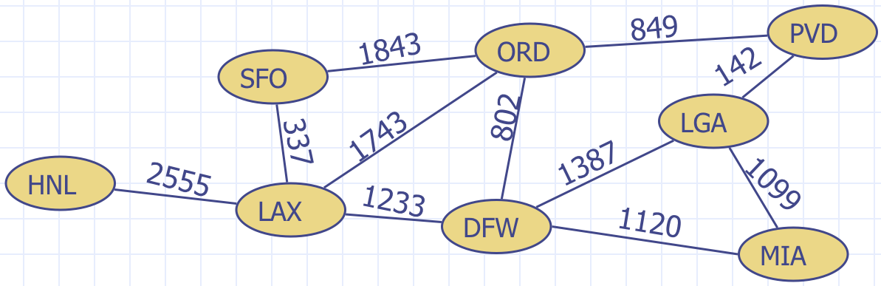
Graphs
A graph is a pair (V, E), where
V is a set of nodes, called vertices
E is a collection of pairs of vertices, called edges
Vertices and edges are positions and store elements
Example:
A vertex represents an airport and stores the three-letter airport code
An edge represents a flight route between two airports and stores the mileage of the route

Slide 4
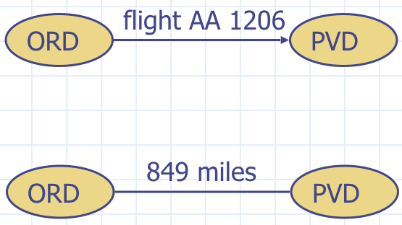
Graphs and Edges
Directed edge
ordered pair of vertices (u,v)
first vertex u is the origin
second vertex v is the destination
e.g., a flight
Directed graph
all the edges are directed
e.g., route network
Undirected edge
unordered pair of vertices (u,v)
e.g., a flight route
Undirected graph
all the edges are undirected
e.g., flight network

Slide 5
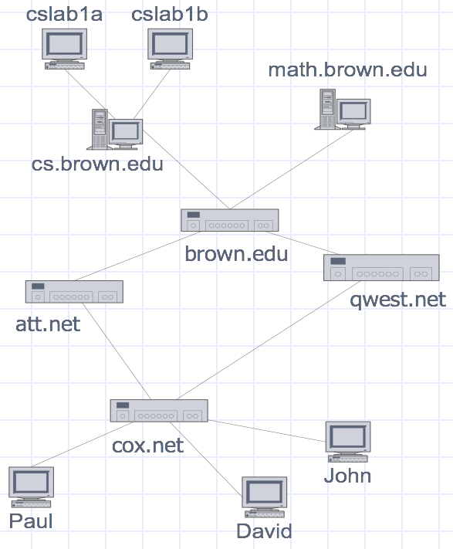
Graph Applications
Electronic circuits
Printed circuit board
Integrated circuit
Transportation networks
Highway network
Flight network
Computer networks
Local area network
Internet
Web

Slide 6
Graph Database
Nodes represent entities: people, businesses, accounts, or any other item to be tracked.
Equivalent (Roughly) of record/relation/row in relational DB or document in a document database.
Edges represent the relationship between nodes.
Meaningful patterns emerge when examining the connections and interconnections of nodes, properties, and edges.
Properties are relevant information to nodes.
Example, if Wikipedia was a nodes, properties could be website or reference material

Slide 7
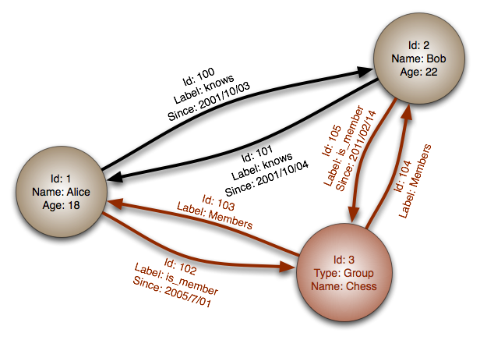
Graph Database
Bob and Alice know each other
Bob and Alice are members of the Chess Group
Bob has been a member since February, 14, 2011
Alice has been a member since July, 1, 2005

Slide 8
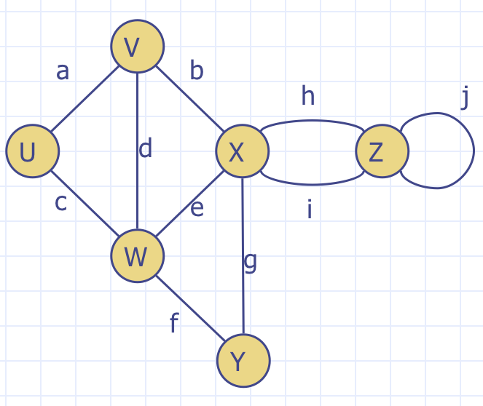
Graph Terminology
U and V are the endpoints of a
End vertices (or endpoints) of an edge
a, d, and b are incident on V
Edges sharing a vertex are incident
U and V are adjacent
Adjacent vertices are share an edge

Slide 9
Graph Terminology
X has degree 5
Degree of a vertex is the number of edges incident
h and i are parallel edges
Edges that are incident to the same two vertices
j is a self-loop
An edge that connects a vertex to itself

Slide 10
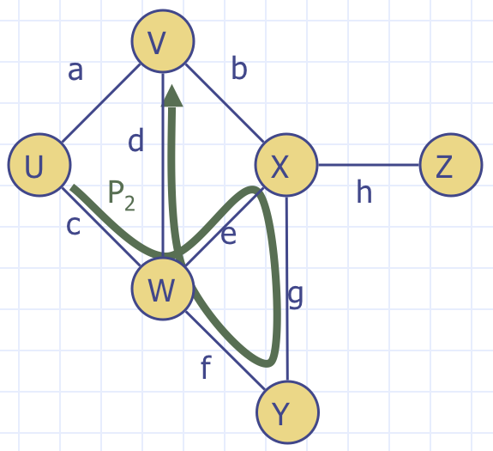
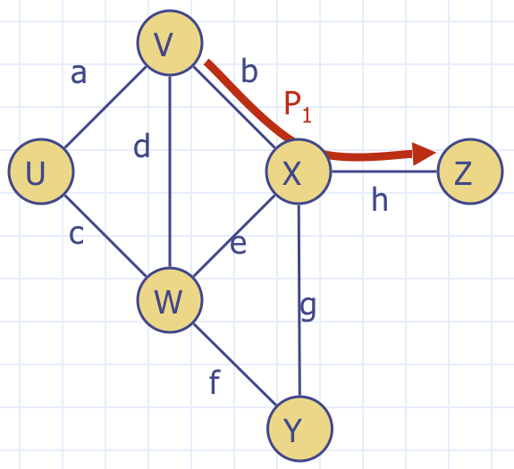
Graph Terminology
Path Sequence of alternating vertices/edges Begins and ends with a vertex Edges preceded and followed by endpoints
P₂ = (U,c,W,e,X,g,Y,f,W,d,V) (not simple path)
Simple Path Path such that all its vertices and edges are distinct
P₁ = (V,b,X,h,Z) (simple path)

Slide 11
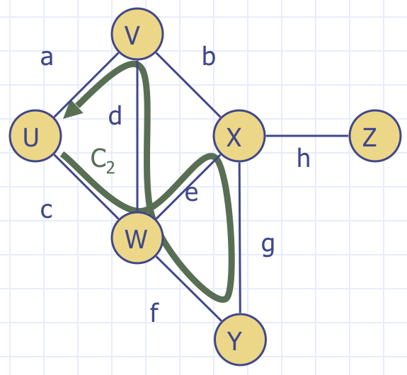
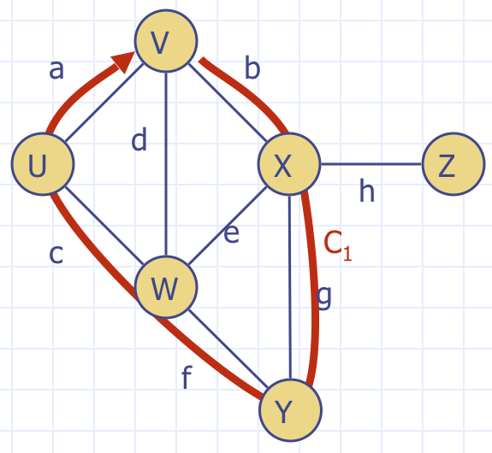
Graph Terminology
Cycle Circular sequence of vertices/edges Edges preceded and followed by endpoints
C₂ = (U,c,W,e,X,g,Y,f,W,d,V,a,↵) (not simple cycle)
Simple Cycle Cycle such that all its vertices and edges are distinct
C₁ = (V,b,X,g,Y,f,W,c,U,a,↵) (simple cycle)

Slide 12
Graph Properties
Property 1: Total contribution of the edges
Σ_{v} deg(v) = 2m
Each edge is counted twice
Example: 2m = 12 = Σ_{v} deg(v)
Property 2: Simple graph with n vertices has O(n²) edges.
In an undirected graph with no self-loops and no parallel edges: m ≤ (n / 2) (n − 1)
Each vertex has degree at most (n − 1)
Example: 6 ≤ (4 / 2) (4 - 1)
Notation: n - number of vertices m - number of edges deg(v) - degree of vertex v
Example: n = 4, m = 6, deg(v) = 3

Slide 13
Directed Graph Properties
Property 1: Total contribution of the edges
Σ_{v} indeg(v) = Σ_{v} outdeg(v) = m
Edge contributes one to outdeg of its origin and one to indeg of its destination
Example: Σ_{v} indeg(v) = 6 = Σ_{v} outdeg(v)
Property 2: Simple graph with n vertices has O(n²) edges.
In an directed graph with no self-loops and no parallel edges: m ≤ n (n − 1)
Each vertex has indeg of at most (n − 1), an outdeg of at most (n − 1), and (indeg(v) + outdeg(v)) ≤ (n - 1)
Example: 6 ≤ 4 (4 - 1)
Notation: n - number of vertices m - number of edges indeg(v) - Incoming deg. of vertex v outdeg(v) - Outgoing deg. of vertex v
Example: n = 4, m = 6

Slide 14
Graph ADT
Vertices and edges are positions that store elements
Accessor methods:
e.endVertices(): a list of the two end vertices of e
e.opposite(v): the vertex opposite of v on e
u.isAdjacentTo(v): true if and only if u and v are adjacent
*v: reference to element associated with vertex v
*e: reference to element associated with edge e
Update methods:
insertVertex(o): insert a vertex storing element o
insertEdge(v, w, o): insert an edge (v, w) storing element o
eraseVertex(v): remove vertex v (and its incident edges)
eraseEdge(e): remove edge e
Iterable collection methods:
incidentEdges(v): list of edges incident to v
adjacentVertices(v): lists all vertices that share an edge from the vertex v
vertices(): list of all vertices in the graph
edges(): list of all edges in the graph

Slide 15
A Note on the Data Structures in the Book
The description of the data structures in the book are fully featured
These are not the only ways to implement graph data structures
In this presentation, I will show less complicated versions of each of the methods for storing a graph
After seeing these versions of graph data structures, section 13.2 should make more sense

Slide 16
Graph Data Structures
Adjacency List:
Vertices are stored as Records/Objects
Every Vertex stores a list of adjacent Vertices
Allows the storage of additional data on the Vertices
Additional data stored if edges are also Objects
Adjacency Matrix:
Two-dimensional matrix
Rows represent source Vertices
Columns represent destination Vertices
Data on Edges and Vertices stored externally

Slide 17
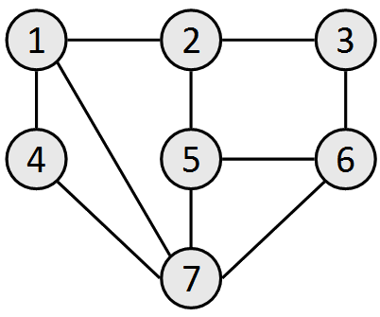
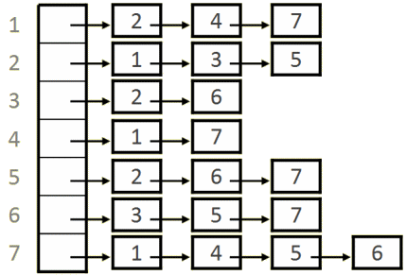
Graph DS: Adjacency List Structure

Slide 18
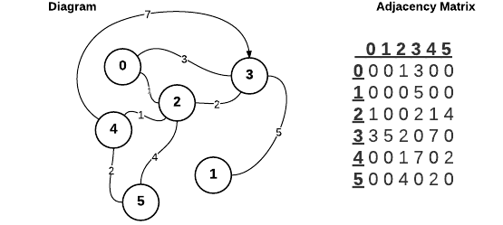
Graph DS: Adjacency Matrix Structure

Slide 19
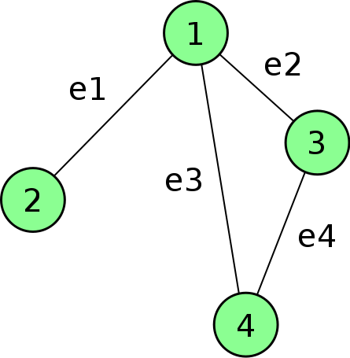
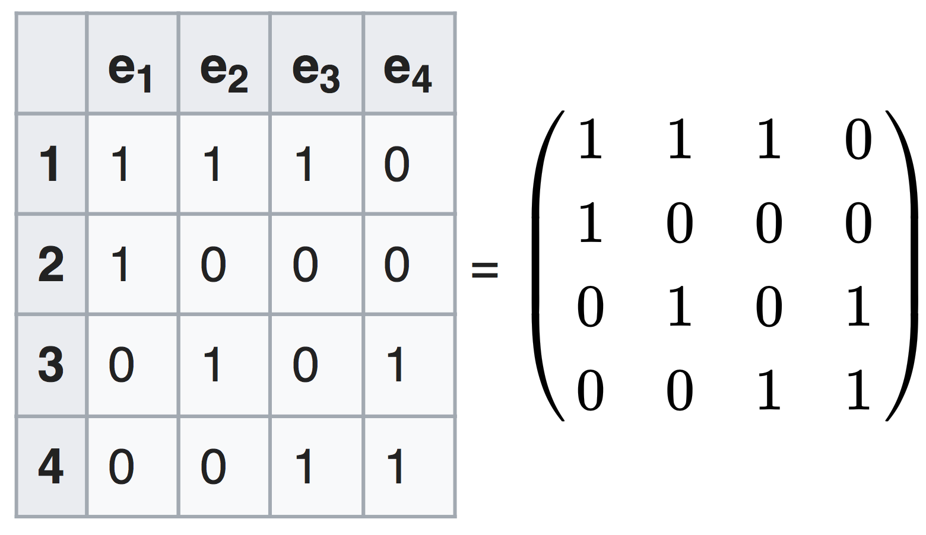
Other Graph Data Structures
Incidence Matrix:
Two-dimensional Boolean matrix
Rows represent the Vertices
Columns represent the Edges
Entries indicate whether the Vertex at a row is incident to the Edge at a column

Slide 20
Graph Data Structures
 | Adjacency list | Adjacency matrix | Incidence matrix
Memory | O( |V| + |E| ) | O( |V|² ) | O( |V| * |E| )
Adding Vertex | O( 1 ) | O( |V|² ) | O( |V| * |E| )
Adding Edge | O( 1 ) | O( 1 ) | O( |V| * |E| )
Removing Vertex | O( |E| ) | O( |V|² ) | O( |V| * |E| )
Removing Edge | O( |V| ) | O( 1 ) | O( |V| * |E| )
V is adjacent to U | O( |V| ) | O( 1 ) | O( |E| )
Pros | Constant time additions | Constant look up times, constant edge addition | Ease of incidence calculations, Interesting math qualities
Cons | Slow removal for list search times | Slow to add/remove vertices for matrix resize/copy | Slow add/remove vertices/edges for matrix resize/copy

Slide 21
Book Data Structures

Slide 22
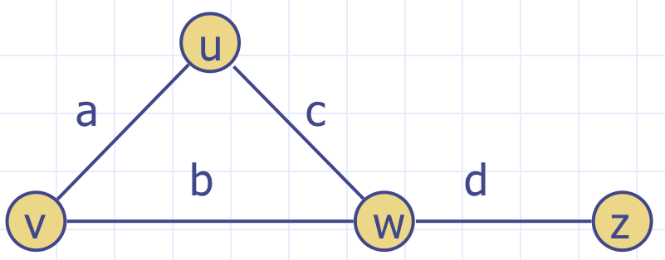
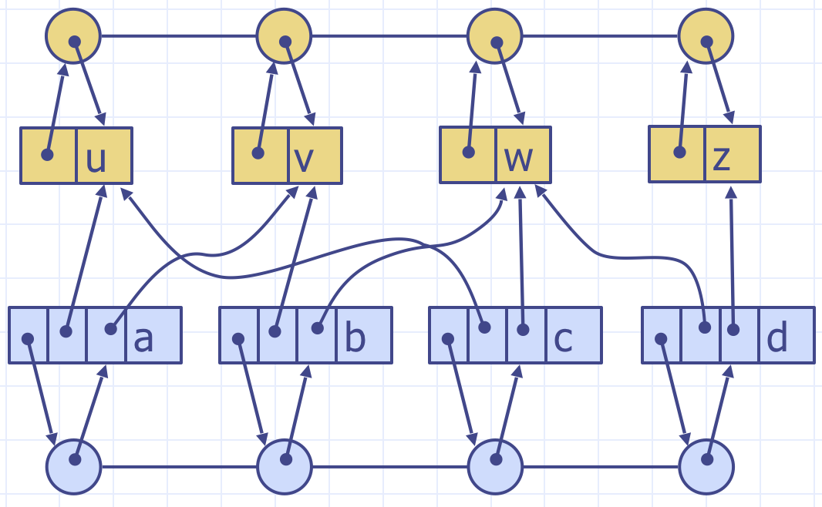
Graph Data Structure: Edge List
Vertex Object
Element
Reference to position in Vertex Sequence
Edge Object
Element
Origin Vertex Object
Destination Vertex Object
Reference to position in Edge Sequence
Vertex Sequence
Sequence of Vertex Object
Edge Sequence
Sequence of Edge Object

Slide 23
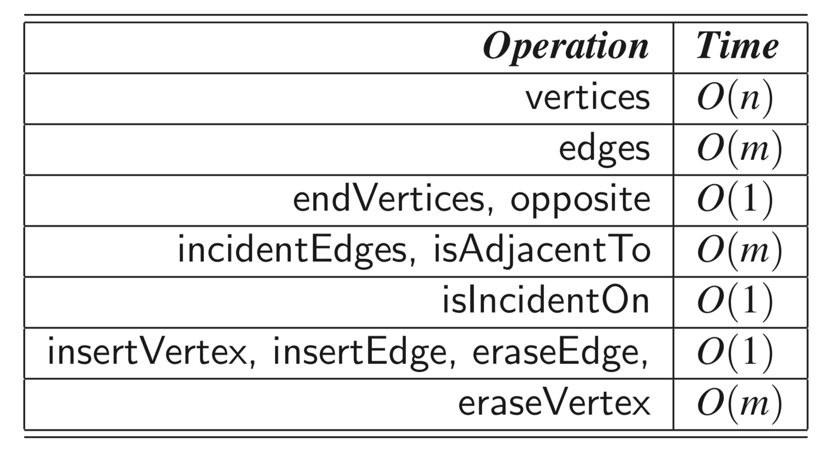
Graph Data Structure: Edge List
Under the assumption that collections V and E are realized with doubly linked lists
Space used is O(n + m), where n is the number of vertices and m is the number of edges

Slide 24
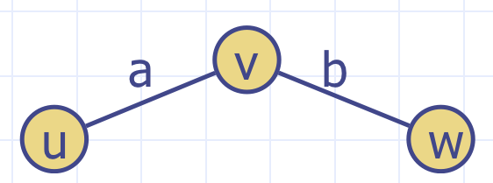
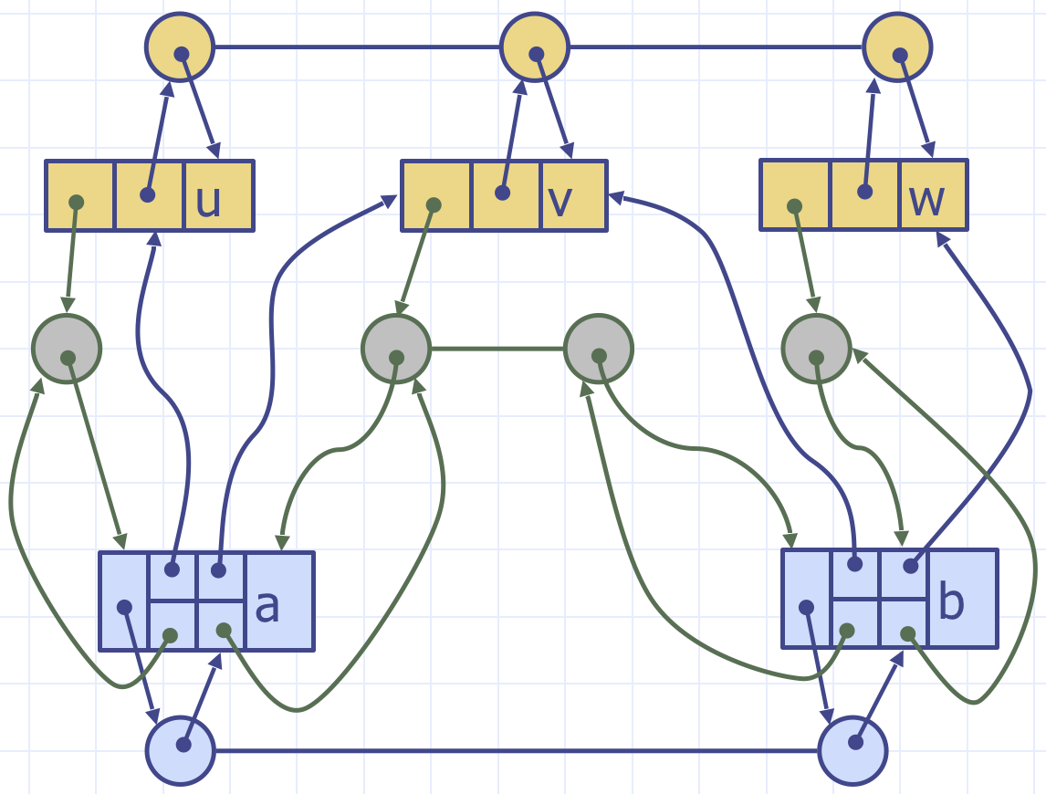
Graph Data Structure: Adjacency List Structure
Incidence Sequence for each Vertex
Sequence of references to Edge Objects of incident edges
Augmented Edge Objects
References to associated positions in Incidence Sequence of end Vertex

Slide 25
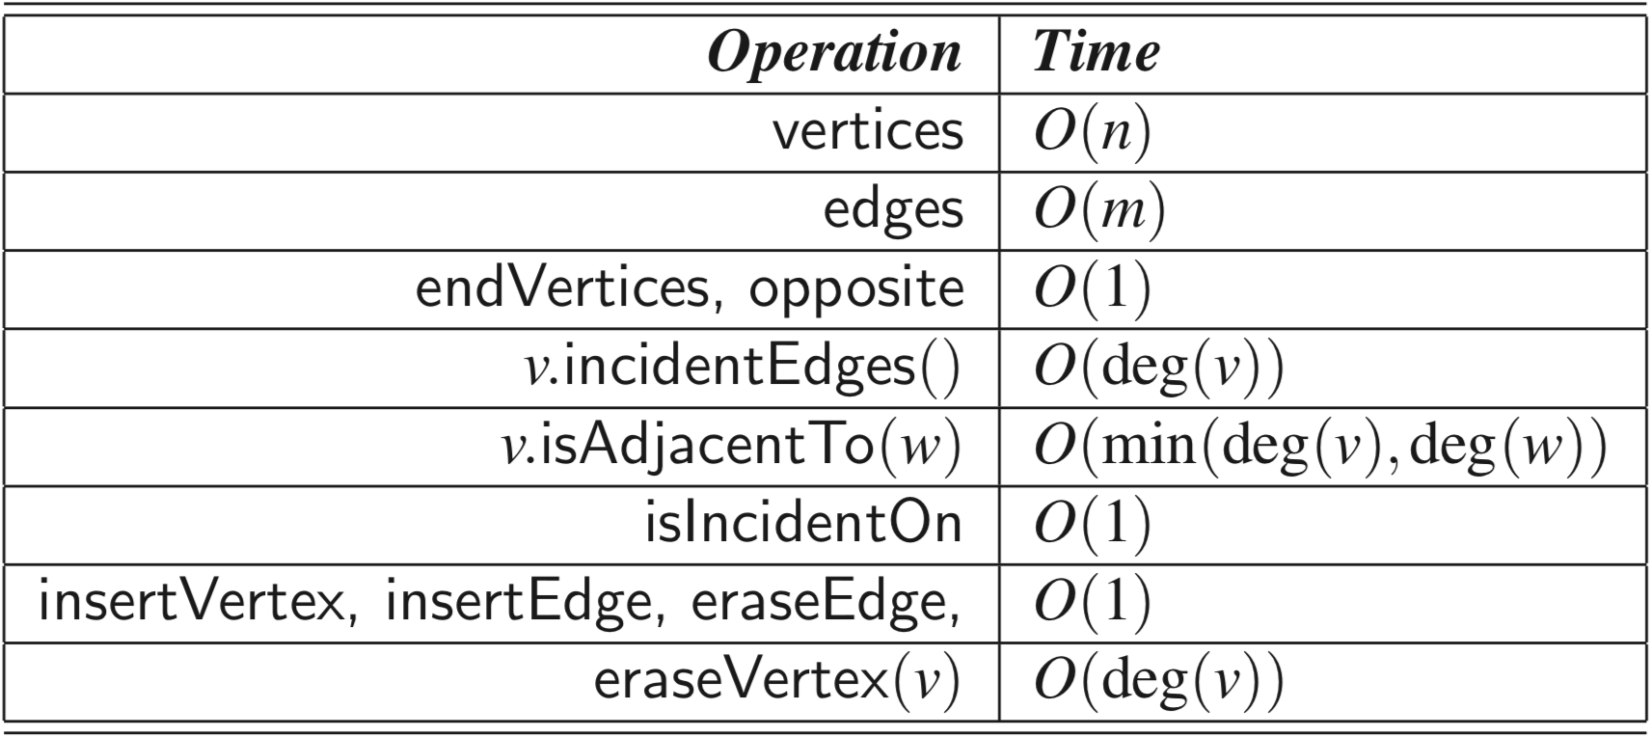
Graph Data Structure: Adjacency List
Under the assumption that collections V and E are realized with doubly linked lists
Space used is O(n + m), where n is the number of vertices and m is the number of edges

Slide 26
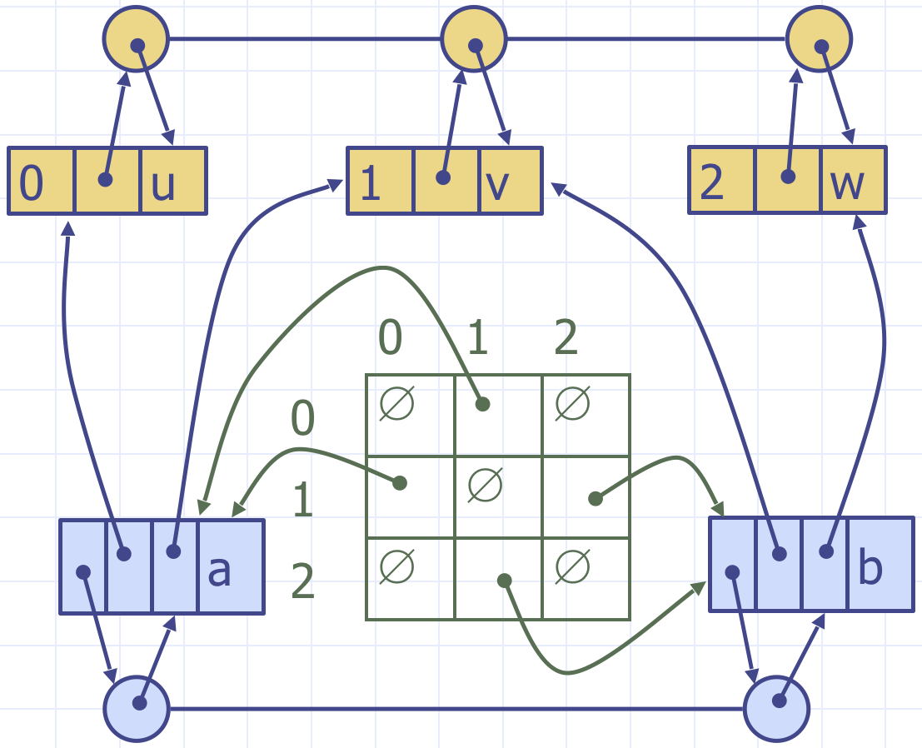
Graph Data Structure: Adjacency Matrix
Augmented Vertex Objects
Integer key (index) associated with vertex
2D-Array Adjacency Array
Reference to Edge Object for adjacent vertices
Null for nonadjacent vertices
The “old fashioned” version just has 0 for no edge and 1 for edge

Slide 27
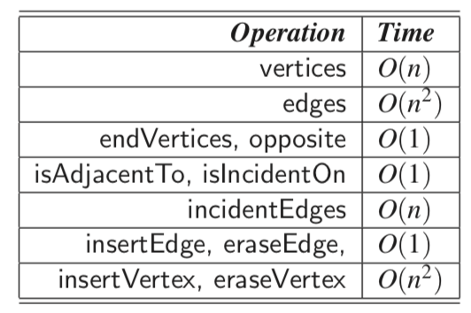
Graph Data Structure: Adjacency Matrix
Under the assumption that collections V and E are realized with doubly linked lists
Space used is O(n*n), where n

Slide 28
Question:
Of the three data structures (Adjacency list, Adjacency matrix, and Incidence matrix), what would be the best memory footprint for a simple undirected graph with:
10 Vertices and 15 Edges? 2 Vertices and 1 Edges?
Notes:
Set a 5 minute timer, say no one can answer until the timer is up.

Slide 29
Answer:
10 Vertices and 15 Edges? V + E = 25, V * V = 100, V * E = 150 Adjacency List
2 Vertices and 1 Edges? V + E = 3, V * V = 4, V * E = 2 Incidence Matrix

Slide 30
Question:
Can the worst case memory footprint of a Adjacency Matrix be smaller than a Adjacency List:
For a simple undirected graph?
For a simple directed graph?
Notes:
Set a 5 minute timer, say no one can answer until the timer is up.

Slide 31
Answer:
n is the number of vertices and m is the number of edges.
Simple Undirected Graph: m ≤ (n / 2) (n − 1) Simple Directed Graph: m ≤ n (n − 1)
Without loops or parallel edges, n will always grow faster than m: O(n + m) ≤ O(n²)
So the answer is No. The best they can be is equal

